Slide 1
The Alaska Forest Disturbance Carbon Tracking System
T. Loboda, E. Kasischke, C. Huang (Univ. MD), N. French (MTRI) J. Masek, J. Collatz (GSFC), D. McGuire, H. Genet (Univ. AK), E. Hoy (Sigma Space)
NASA Carbon Monitoring System Science Team Meeting & CMS Applications Workshop (Nov. 12-14, 2014)

Slide 2
Project Motivation
Estimates of emissions from boreal forest fires are large, and are not accurately represented in national estimates reported by the EPA
Assessing changes in carbon stocks in Alaska’s boreal forests is challenging
No forest inventory data
Dominant forest type (black spruce) has large organic soil carbon stocks
Significant reductions in soil organic carbon occur during fires
Challenging conditions for satellite observations in the optical range

Slide 3
Alaska fires emissions from Kasischke and Hoy (2012) study are 40% greater than GFED
Alaska fire emissions (including tundra fires) represent 60% of U.S. total

Slide 4
Project Goal
Create a multi-source data archive characterizing carbon on the landscape and consumption conditions.
Develop medium resolution (60 m), daily maps of direct carbon consumption during fires for the Alaskan boreal forest region for 2001 to 2010
Assess utility of time-series Landsat ETM+ data for mapping variations in post-fire succession in Alaska’s boreal forest

Slide 5
Overall Approach
Management agency data
Satellite sources
Management agency data
Terrestrial Ecology Model outputs
Field observations

Slide 6
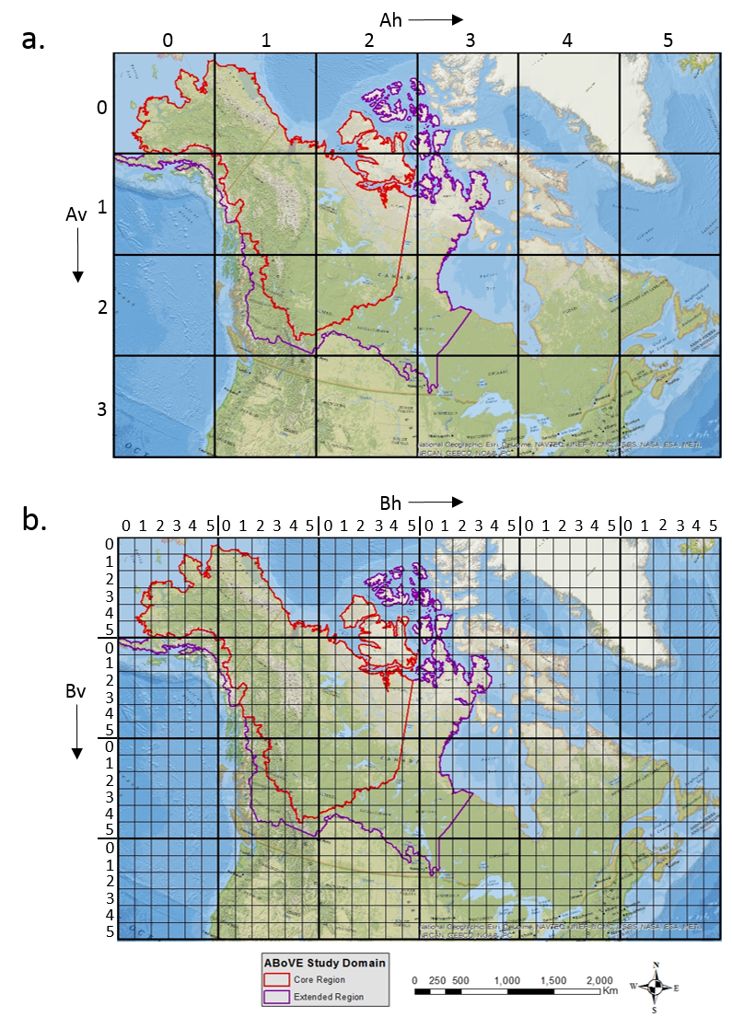
Data archive and the ABoVE grid system
3 single-year datasets at 60 m for the Interior Alaska
3 annual datasets at 60 m 2001-2010
10 daily (end of May – beginning of September) weather datasets 2001-2010
4 single-year TEM outputs (re-gridded to 60 m)

Slide 7
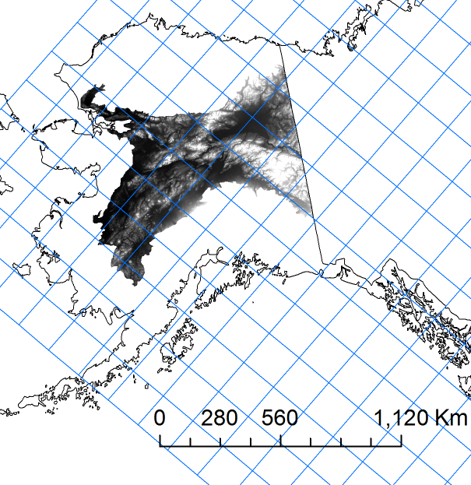
ABoVE grid for the CMS tiles

Slide 8
Unique Aspects of Study
High spatial and temporal resolution data input and output data
Estimation of fuel loads using TEM
Field-based models from the Canadian Forest Service to estimate fuel consumption
Ground-layer fuel consumption based on extensive field measures in mature and 30 to 50 year old black spruce stands
Identification of areas with short to intermediate fire free intervals (areas that had previously burned between 1950-2000

Slide 9
Output Product – for each pixel for 222 fire events
Site Characteristics
Disturbance Information
Post-fire Stand Characteristics

Slide 10
Output I. Site Characteristics
Pre-stand site characteristics (only for areas impacted by disturbance)
Vegetation cover classes (spruce, mixed, deciduous, shrub, herbaceous)
Topography (slope, aspect, elevation)
Drainage category (poor, moderate, well)
Carbon present in different fuel categories (ground layer, dead woody debris, crown fuels, woody fuels)
Year of previous fire event (1950-2000)
Year of previous insect disturbance (1989-2010)

Slide 11
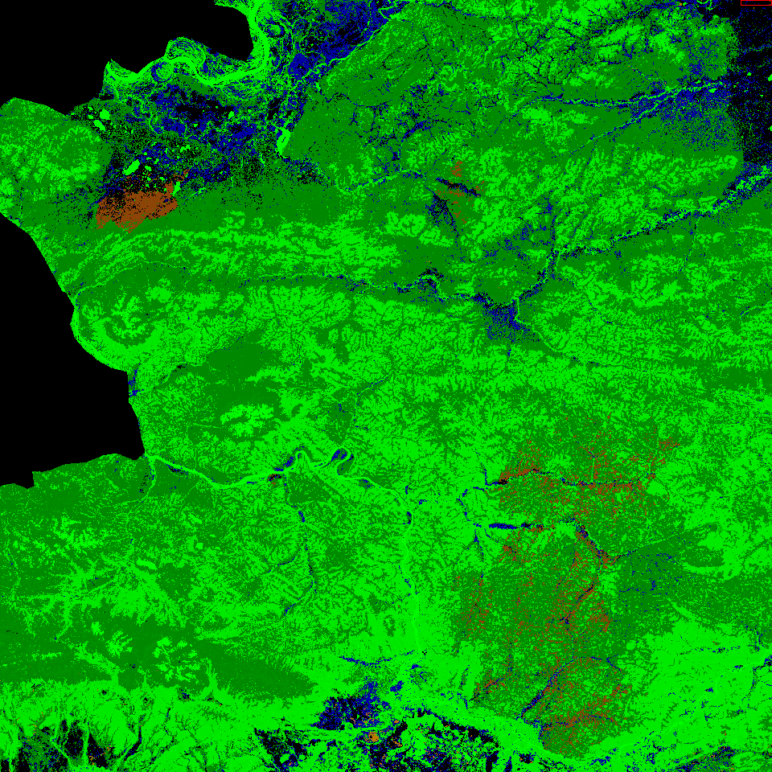
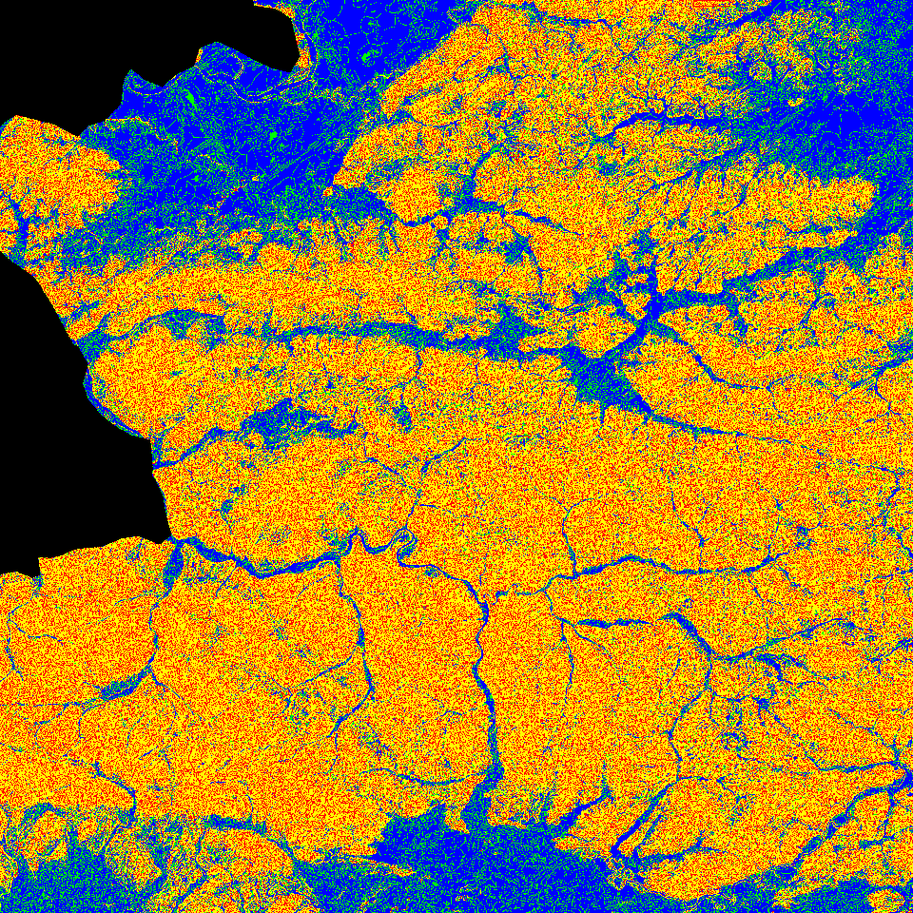
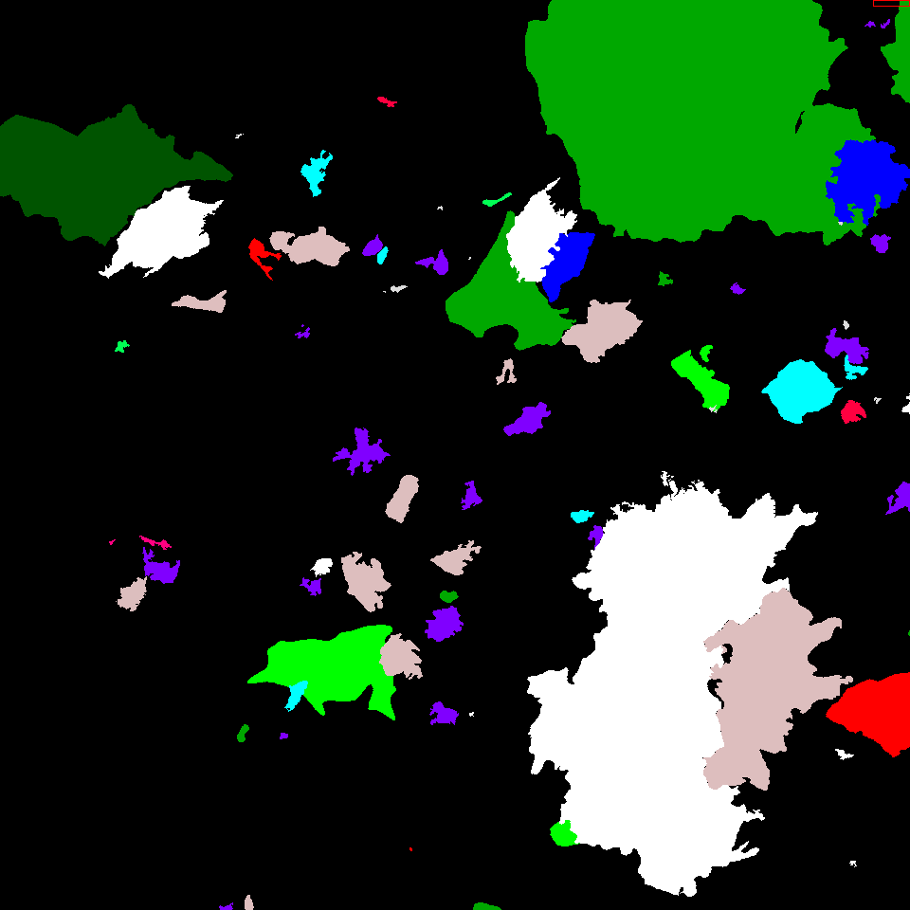
Site characteristics
Land Cover
Drainage
Previous Disturbance

Slide 12
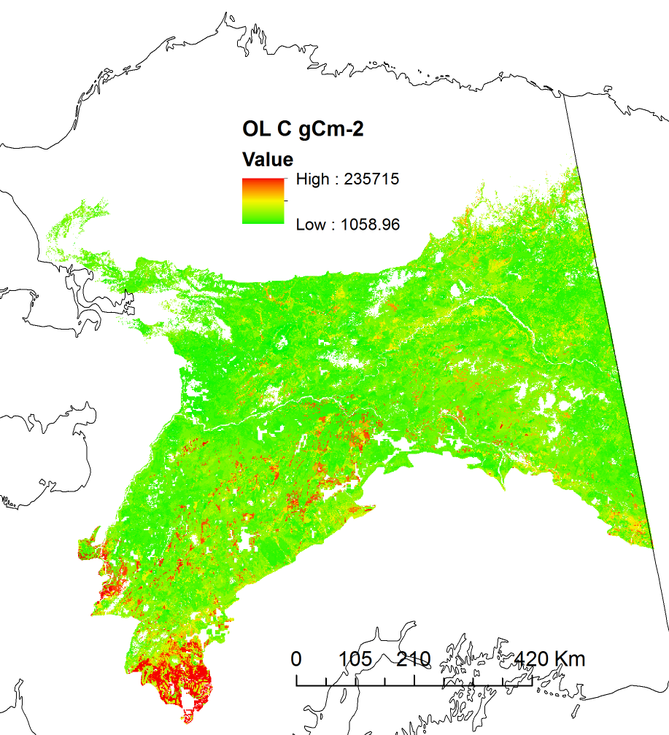
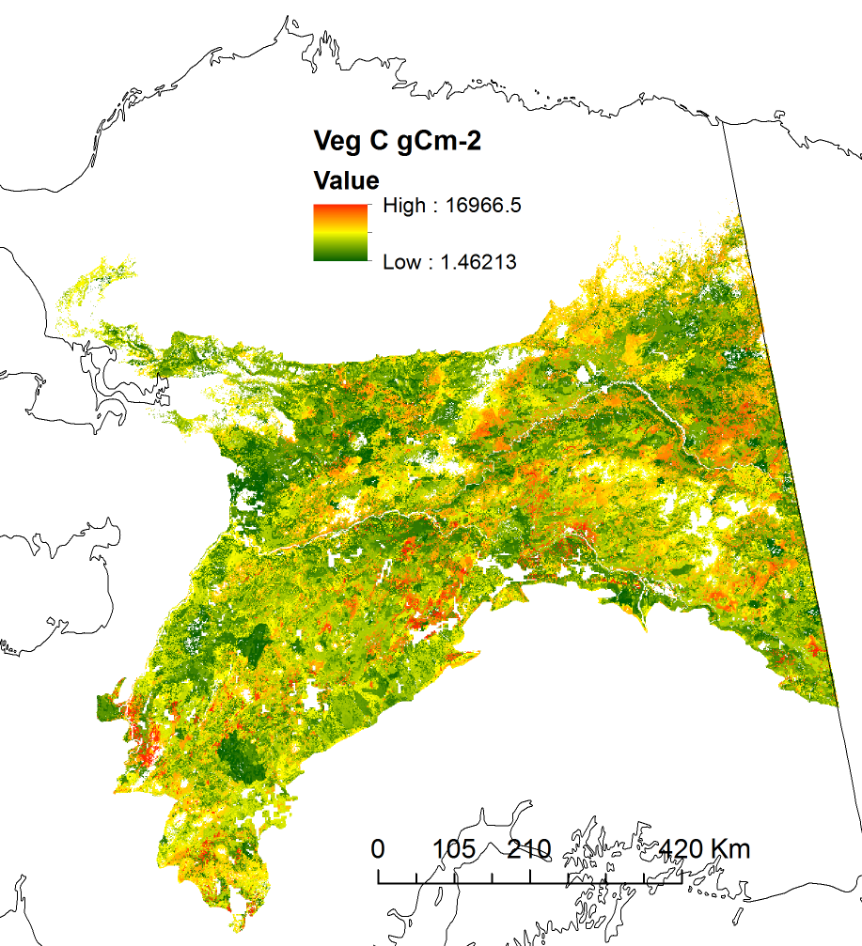
Carbon loads (TEM)

Slide 13
Output II. Disturbance information
Year of disturbance event (s)
Disturbance perimeter location (dNBR perimeter)
For insect, disturbance type
For areas within fires, each pixel classified as burned/unburned (dNBR data)
For fire, dNBR value from MTBS project
Date of burn (from MODIS)
Fire weather indices on date of burn

Slide 14
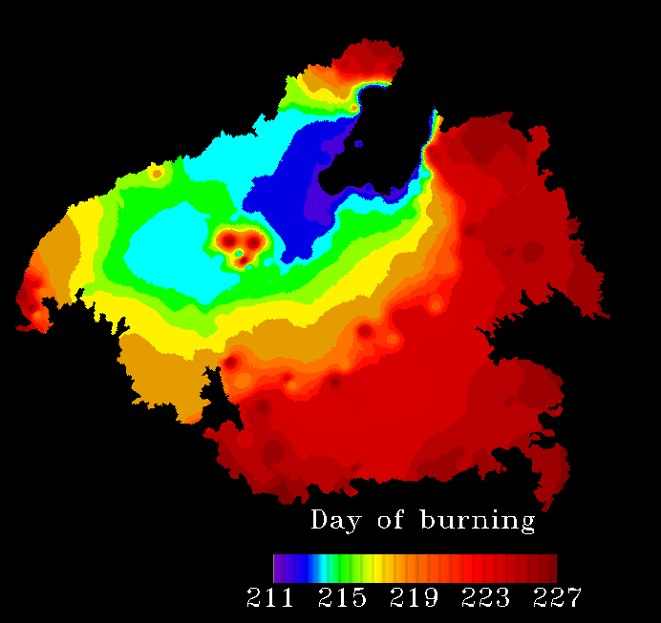
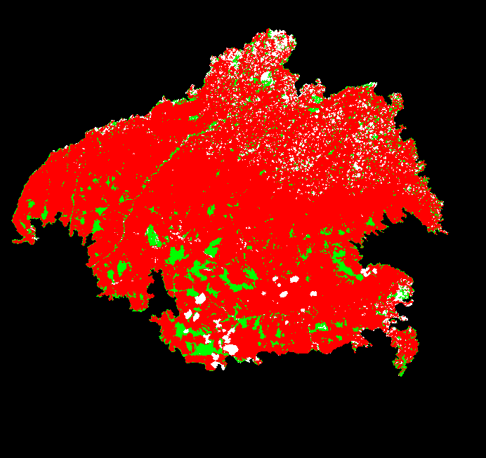
Characteristics of fire
Burned/ unburned

Slide 15
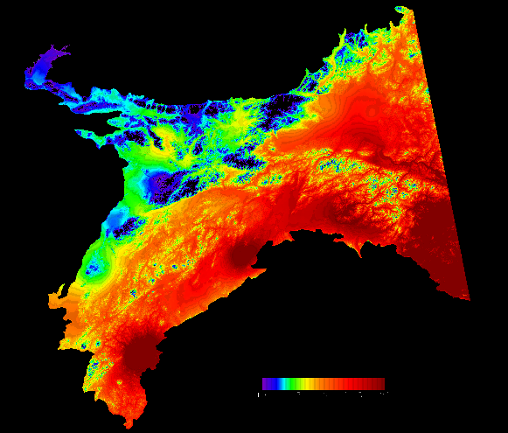
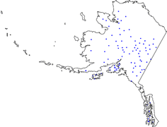
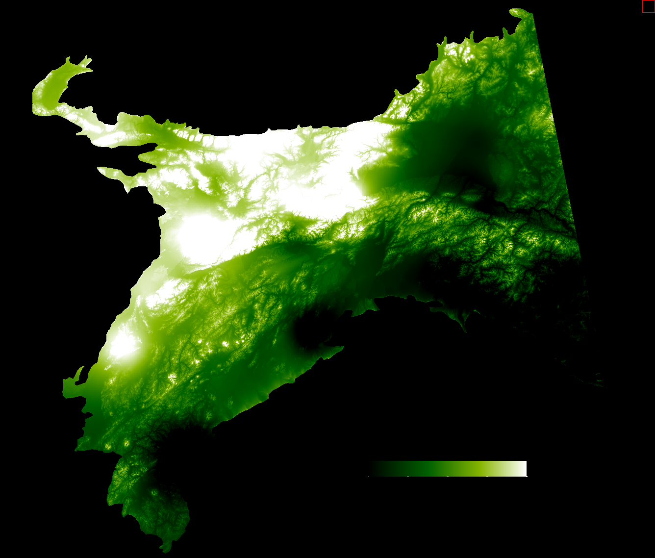
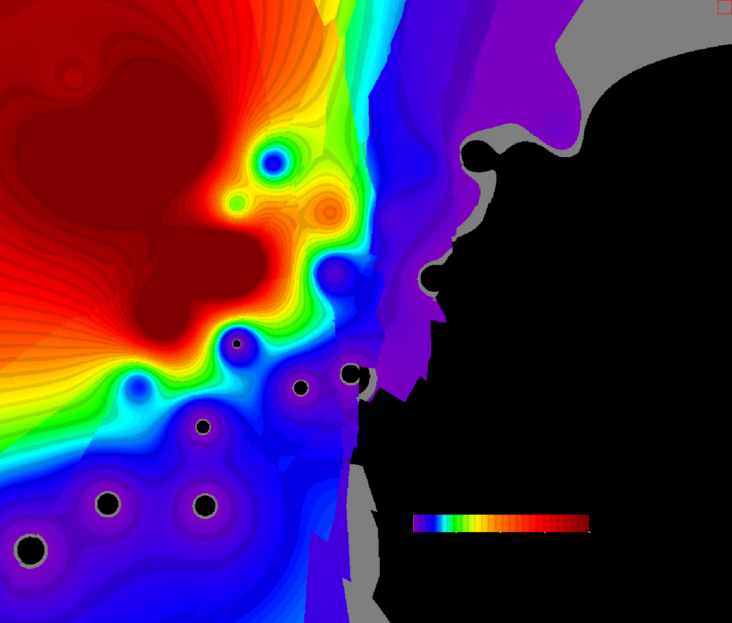
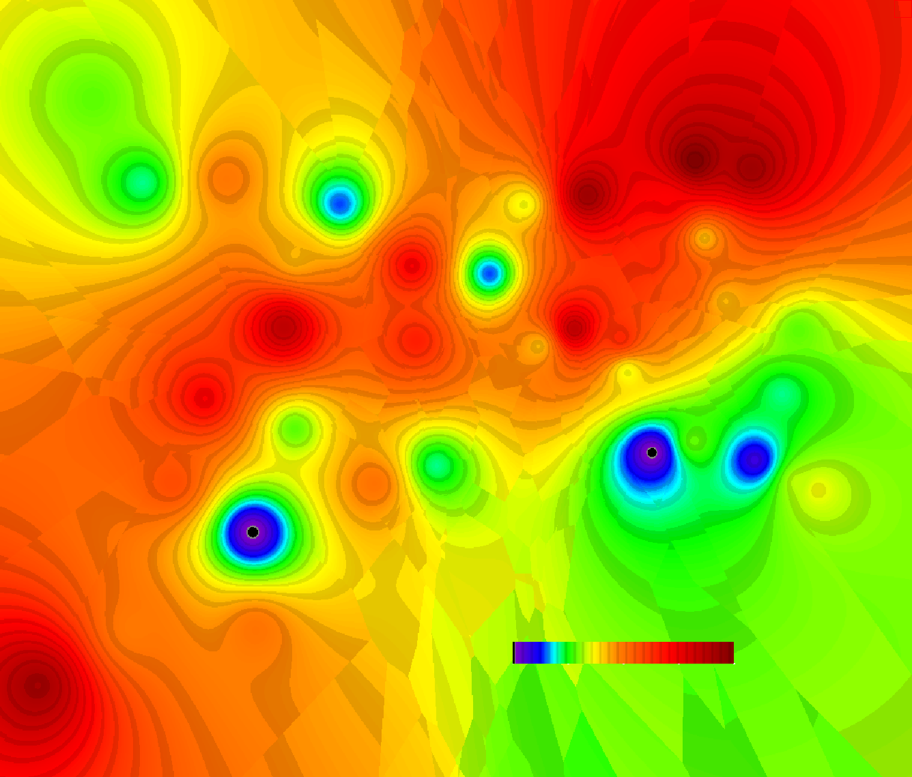
Weather variables
Remote Access Weather Stations (RAWS)
Temp, Prec, RH, Windspeed → Fire Weather Indices
T(C)
Aug 9, 2001
10
28
RAWS Locations
RH %
Precipitation mm
Wind ms-1
5
100
0
10
0
66

Slide 16
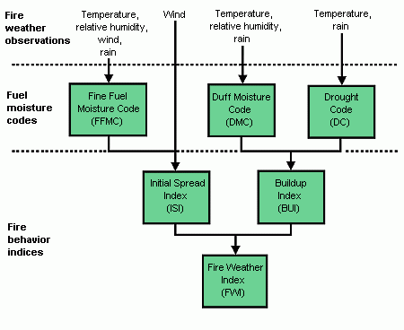
Characteristics of consumption
Canadian Fire Weather System

Slide 17
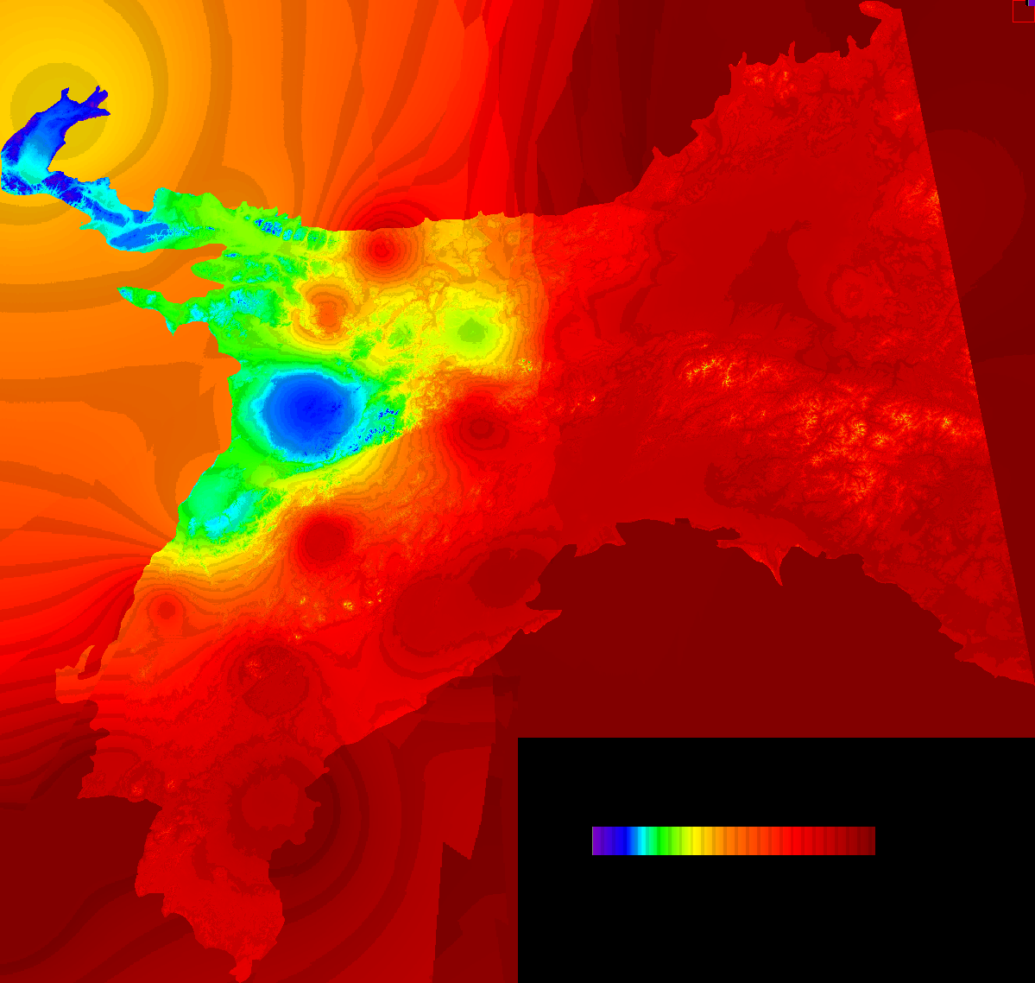
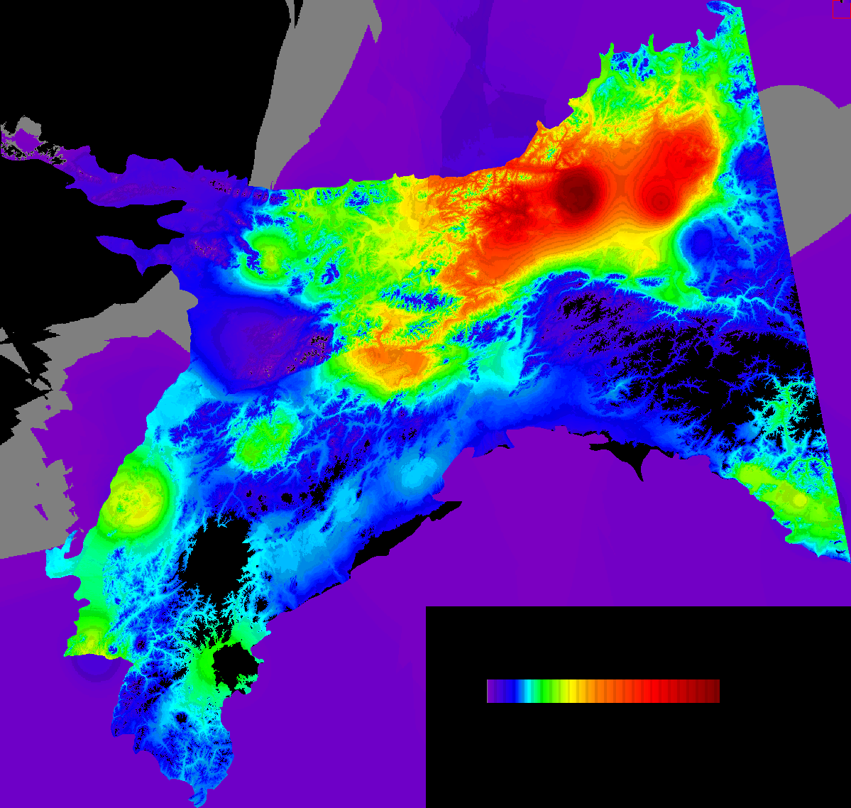
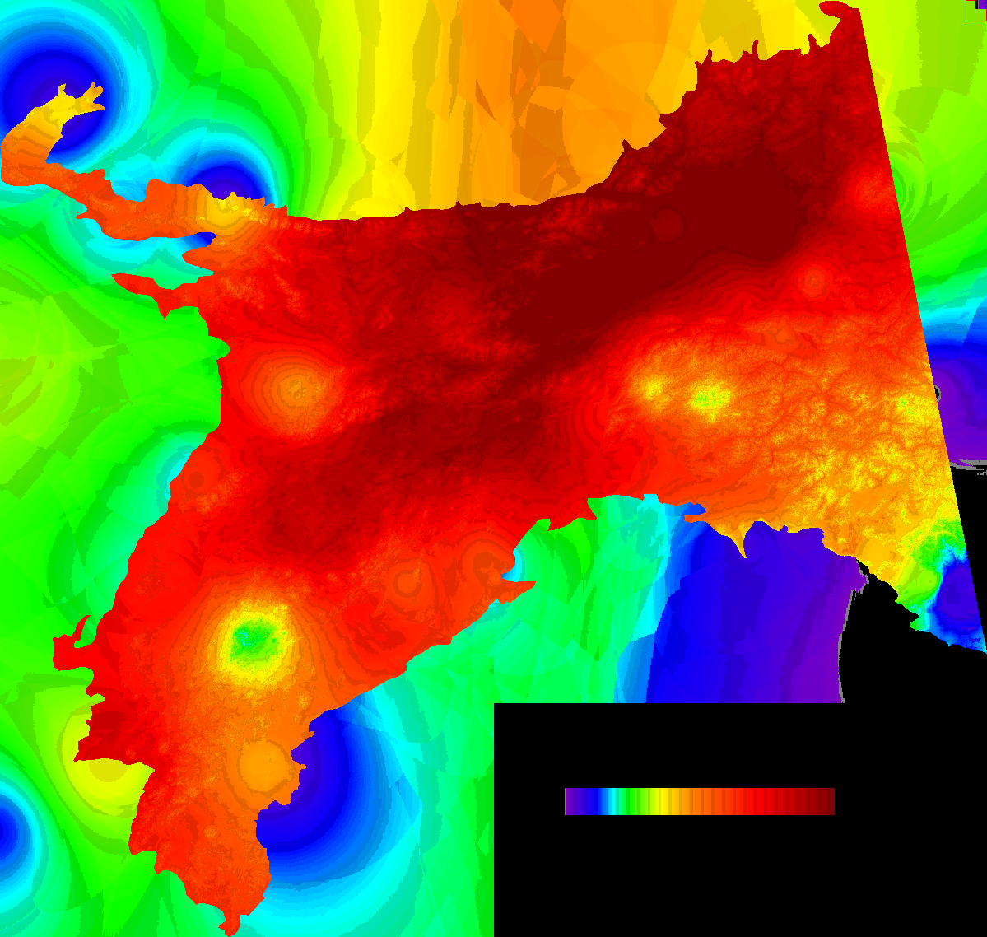
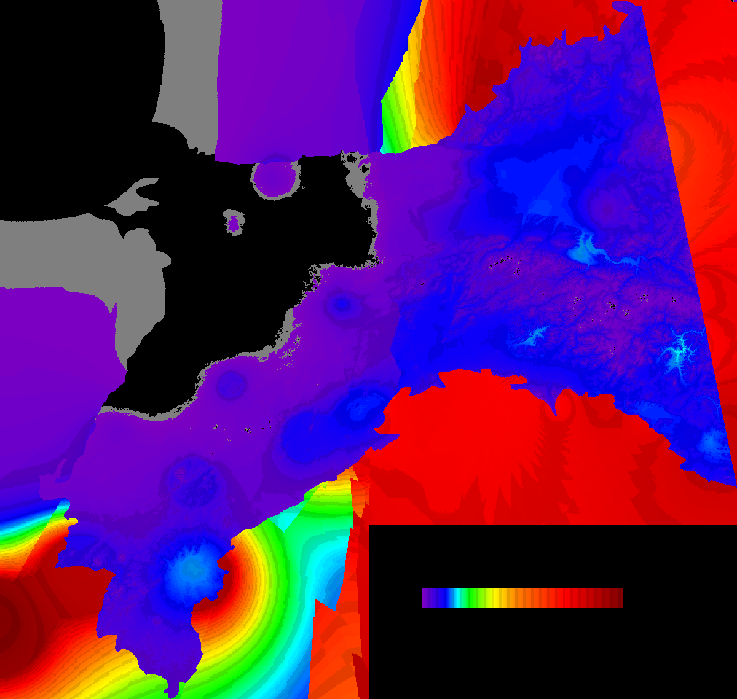
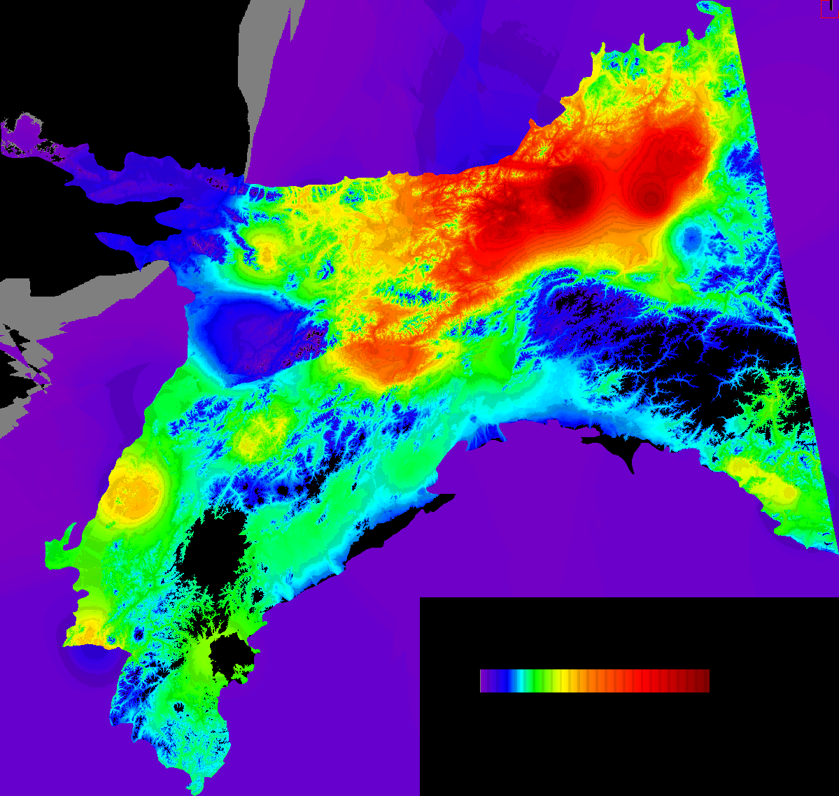
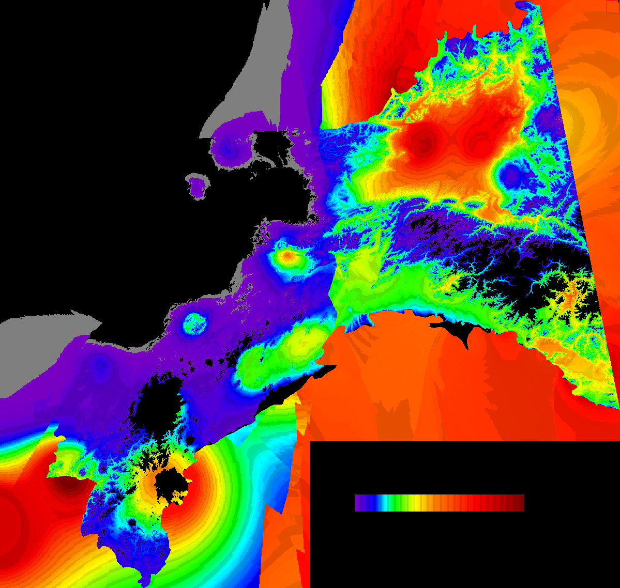
Fire weather
Aug 9, 2001
FFMC
DMC
DC
ISI
BUI
FWI

Slide 18
Output III. Post-fire stand characteristics
Post-disturbance carbon present in different fuel categories
Carbon loss in different fuel categories

Slide 19
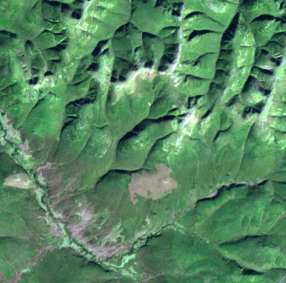
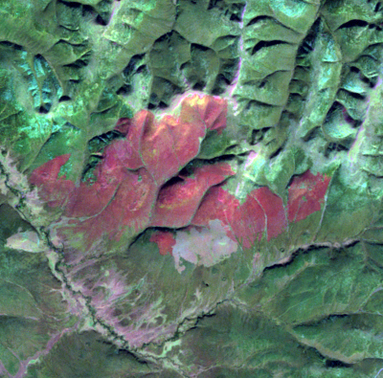
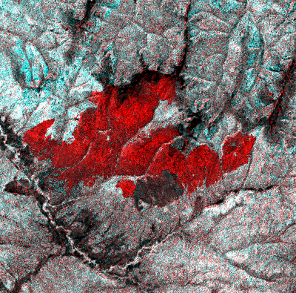
Tracking Tree Cover Change before and after Fire Using Landsat
Landsat, 1995
Landsat, 1999
1999 fire
Derived 30-m VCF using cloud free images
Large tree cover decrease after fire
No obvious recovery in tree cover during observing period
Pre-95 fire
Color composite of 1995 (R) and 1999 (G & B) 30-m VCF
1999 fire
Tree cover (%)
Pre-95 fire
Year

Slide 20
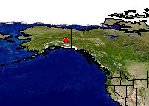
Assessing Landsat Data Availability for Time Series Analysis
Three path/rows evaluated
p66/r15
    Only 8 cloud free images 1984-2014
    Many years no usable images (leaf-off, cloud cover > 60%)
        Mostly in 1980s and 1990s
    Similar patterns for p65/r15 and 067r15
Time series possible by cloud clearing compositing
    Before 2000, > 5-year intervals
    After 2000, ~2-year intervals
        Very cloudy, short growing season
More frequent usable observations when Sentinel-1 and -2 satellites in operation

Slide 21
Future Activities
Implement fuel consumption algorithms
Integrate 1km TEM outputs into 60 m assessment
Generate carbon consumption maps for 222 fire events (includes day of burn for each pixel
Compare results to estimates from Global Fire Emissions Dataset (GFED) and outputs from the MTRI Wildland Fire Emissions Information System (WFEIS)

